Slide 1
SQL Server Memory
Module 3

Slide 3
Learning Units covered in this Module
Lesson 1: Windows Memory Management
Lesson 2: SQL Server Memory Management
Lesson 3: Troubleshooting SQL Server memory

Slide 4
Lesson 1: Windows Memory Management

Slide 5

Objectives
After completing this learning, you will be able to:
Understand Windows Memory Management

Slide 6
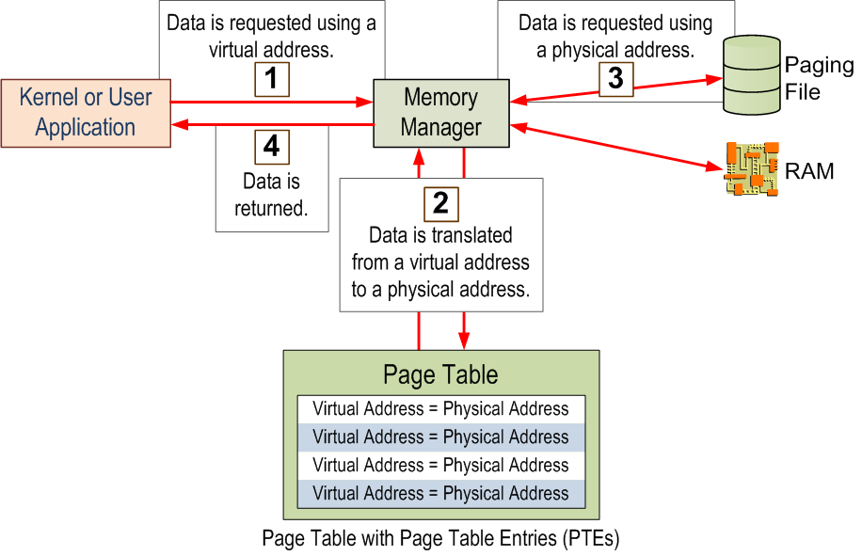
Windows Memory Access
Notes:
Key Points:
The operating system controls the allocation of memory and decides whether data is stored in RAM or Paging File depending on the amount of RAM available. Applications do not need to know where their data resides, nor can they guarantee that it will always be available in RAM.
Windows uses the Page Table to store the mapping of Virtual Addresses to Physical Addresses. Even if there is memory available, if there is no more room in the Page Table, no more memory allocations can be made. With modern systems, there is likely no need to monitor PTEs, but in 32-bit systems with /3GB and /PAE enabled, running out of PTEs was more common. If students are not interested in 32-bit architecture, you can skip this point.
GLOBAL: Do not capitalize generic terms. Please note that we do not capitalize terms unless they are from the UI or are feature or product names. Please consider lowercasing such terms throughout this document.
Expand PTE (Page Table Entry) and PAE (physical address extension)
Please validate if this is factually correct.

Slide 7
Page File Considerations
Consists of infrequently accessed pages
Sizing the Page File appropriately
System-managed page files
Monitor the Windows Server workload
Perfmon Counter: (\Paging Files(*)\% Usage)
Crash dump setting
Notes:
You can change the location of where the page file is located on Windows 2008+ https://support.microsoft.com/en-us/kb/969028
When implementing new Windows Server 2012 and later servers, and initially there is no workload to determine the correct size for the Page file, the best option available is to set as System-Managed Page Files.
With System-Managed Page Files, it should give 1GB-4GB or 1GB-3x RAM on Windows Server 2012 and later.
If the Windows Server currently has a workload running. it is possible to monitor the server and determine what is the right size for the Page file.
Use the following considerations for page fill:
Crash dump setting: If you want a crash dump file to be created during a system crash, a page file or a dedicated dump file must exist and be large enough to back the system crash dump setting. Otherwise, a system memory dump file is not created.
Peak system commit charge: The system commit charge cannot exceed the system commit limit. This limit is the sum of physical memory (RAM) and all page files combined. If no page files exist, the system commit limit is slightly less than the physical memory installed. Peak system-committed memory usage can vary greatly between systems. Therefore, physical memory and page file sizing also varies.
Quantity of infrequently accessed pages: The purpose of a page file is to back infrequently accessed modified pages so that they can be removed from physical memory. This provides more available space for more frequently accessed pages. The "\Memory\Modified Page List Bytes" performance counter measures, in part, the number of infrequently accessed modified pages that are destined for the hard disk. However, be aware that not all the memory on the modified page list is written out to disk. Typically, several hundred megabytes of memory remains resident on the modified list. Therefore, consider extending or adding a page file if all the following conditions are true:
More available physical memory (\Memory\Available MBytes) is required.
The modified page list contains a significant amount of memory.
The existing page files are fairly full (\Paging Files(*)\% Usage).
Key Points:
Because all processes running on a server get the same size VAS, and the size of the VAS is larger than the maximum amount of physical RAM supported in Windows, it is possible to allocate more virtual memory than the physical memory installed in the server. To accommodate this memory, Windows uses a Paging File (which is also referred to as Virtual Memory) to store data that does not fit in physical RAM.
Because accessing the page file is much slower than accessing RAM, Windows will move data that has not been accessed recently out to the page file when needed. This is called trimming.
On modern systems with large amounts of RAM, there is typically plenty of physical memory to support the needs of the applications on the server. Often a large page file is unnecessary and just wastes disk space. Certainly the old recommendation of 1 ½ or 2 times the size of RAM is outdated.
Additional Reading:
How to determine the appropriate page file size for 64-bit versions of Windows
http://support.microsoft.com/kb/889654
Always use the full product name – Windows Server 2008 and no Windows 2008. Also doe the + indicate Windows Server 2008 and later versions? Please change to that then.
GLOBAL: Do not capitalize generic terms. Please note that we do not capitalize terms unless they are from the UI or are feature or product names. Please consider lowercasing such terms throughout this document.
GLOBAL: Text is overflowing. Please insert a new slide and move some text to that slide.
GLOBAL: 'New' is a red flag term. Please refer to the following guidance on this term and make any necessary changes if required: Is it new? - You may describe a product or service as 'new' if it’s being released to market for the first time or if it’s an existing product or service that has been substantially or significantly updated to qualify as a new version.

Slide 8
Symmetric Multi-Processing (SMP)
Processor
Processor
Processor
Processor
Processor
Processor
Processor
Processor
Cache
Cache
Cache
Cache
Cache
Cache
Cache
Cache
Shared Bus
Memory
Notes:
Key Points:
One major problem with the symmetric multiprocessing (SMP) architecture in high CPU count systems is the contention on the system bus, sometimes referred to as the memory front or front-side bus. This is because with SMP, all CPUs use the same bus to access memory. The more CPUs that use the bus, the more the contention. Increasing the speed of the system bus has only somewhat alleviated the problem. NUMA was designed to bypass the single bus architecture.
NUMA architecture groups CPU and Memory into nodes. Nodes include their own CPUs and memory, and in some cases, their own I/O channels. Each node has its own system bus for the CPUs to reference the node memory. There are interconnects between the nodes to allow the memory to be referenced by other nodes.
Memory local to a node is called local memory. Memory located in another node is referred as foreign or remote memory. Access to foreign memory is often more expensive in time than accessing local memory. The cost of local memory access over the cost of foreign memory access is called the NUMA ratio. A higher NUMA ratio implies a higher performance impact.
Because foreign memory access is slower than accessing memory local to the node, it is important for resource-intensive applications to be NUMA aware. Relying heavily on foreign memory access will make an application run noticeably slower on NUMA hardware. SQL Server is fully NUMA-aware.
Currently, most servers on the market have a NUMA hardware configuration. Typically, each socket represents a NUMA node, although some of the newer hardware hosts 2 nodes per socket.
You can detect if your SQL Server is running on NUMA hardware by examining the startup messages in the SQL Server error log. You will see messages similar to the following:
Node configuration: node 0: CPU mask: 0x000000000000000f:0 Active CPU mask: 0x000000000000000f:0. This message provides a description of the NUMA configuration for this computer. This is an informational message only. No user action is required.
If there are more than just a single message for node 0, the hardware has a NUMA configuration.
Additional Reading: NUMA Support
http://technet.microsoft.com/en-us/query/aa363804
Understanding Non-uniform Memory Access
http://msdn.microsoft.com/en-us/library/ms178144.aspx
Recommendations and guidelines for the "max degree of parallelism" configuration option in SQL Server
http://support.microsoft.com/kb/2806535

Slide 9
Non-Uniform Memory Access (NUMA)
Processor
Processor
Processor
Processor
Processor
Processor
Processor
Processor
Cache
Cache
Cache
Cache
Cache
Cache
Cache
Cache
Memory
Memory
Node 0
Node 1
Interconnect
Notes:
Key Points:
One major problem with the symmetric multiprocessing (SMP) architecture in high CPU count systems is the contention on the system bus, sometimes referred to as the memory front or front-side bus. This is because with SMP, all CPUs use the same bus to access memory. The more CPUs that use the bus, the more the contention. Increasing the speed of the system bus has only somewhat alleviated the problem. NUMA was designed to bypass the single bus architecture.
NUMA architecture groups CPU and Memory into nodes. Nodes include their own CPUs and memory, and in some cases, their own I/O channels. Each node has its own system bus for the CPUs to reference the node memory. There are interconnects between the nodes to allow the memory to be referenced by other nodes.
Memory local to a node is called local memory. Memory located in another node is referred as foreign or remote memory. Access to foreign memory is often more expensive in time than accessing local memory. The cost of local memory access over the cost of foreign memory access is called the NUMA ratio. A higher NUMA ratio implies a higher performance impact.
Because foreign memory access is slower than accessing memory local to the node, it is important for resource-intensive applications to be NUMA aware. Relying heavily on foreign memory access will make an application run noticeably slower on NUMA hardware. SQL Server is fully NUMA-aware.
Currently, most servers on the market have a NUMA hardware configuration. Typically, each socket represents a NUMA node, although some of the newer hardware hosts 2 nodes per socket.
You can detect if your SQL Server is running on NUMA hardware by examining the startup messages in the SQL Server error log. You will see messages similar to the following:
Node configuration: node 0: CPU mask: 0x000000000000000f:0 Active CPU mask: 0x000000000000000f:0. This message provides a description of the NUMA configuration for this computer. This is an informational message only. No user action is required.
If there are more than just a single message for node 0, the hardware has a NUMA configuration.
Additional Reading: NUMA Support
https://techcommunity.microsoft.com/t5/sql-server-support/sql-server-clarifying-the-numa-configuration-information/ba-p/316753
Understanding Non-uniform Memory Access
https://docs.microsoft.com/en-us/previous-versions/sql/sql-server-2008-r2/ms178144(v=sql.105)
Recommendations and guidelines for the "max degree of parallelism" configuration option in SQL Server
https://support.microsoft.com/en-us/help/2806535/recommendations-and-guidelines-for-the-max-degree-of-parallelism-confi

Slide 10
NUMA (Non-Uniform Memory Access) Architecture
Offers nodes of processors each with its own bus for access for local memory.
Interconnect between nodes allows one node to get to other’s memory.
Offers scalability for NUMA-aware applications.
NUMA-aware applications such as SQL Server try to avoid remote or foreign memory access.
Non-Uniform Memory Access
(NUMA)
Memory
CPU 0
CPU 1
CPU 3
CPU 2
Memory
CPU 4
CPU 5
CPU 7
CPU 6
NUMA NODE 0
NUMA NODE 1
Foreign
Memory
Access
‘n’ x local
Local Memory Access
‘n’ >3 (typically) but varies with hardware design
Notes:
Key Points:
NUMA architecture groups CPU and Memory into nodes. Nodes include their own CPUs and memory, and in some cases, their own I/O channels. Each node has its own system bus for the CPUs to reference the node memory. There are interconnects between the nodes to allow the memory to be referenced by other nodes.
Memory local to a node is called local memory. Memory located in another node is referred as foreign or remote memory. Access to foreign memory is often more expensive in time than accessing local memory. The cost of local memory access over the cost of foreign memory access is called the NUMA ratio. A higher NUMA ratio implies a higher performance impact.
Because foreign memory access is slower than accessing memory local to the node, it is important for resource-intensive applications to be NUMA-aware. Relying heavily on foreign memory access will make an application run noticeably slower on NUMA hardware. SQL Server is fully NUMA-aware.
Currently, most servers on the market have a NUMA hardware configuration. Typically each socket represents a NUMA node, although some of the newer hardware hosts 2 nodes per socket.
You can detect if your SQL Server is running on NUMA hardware by examining the startup messages in the SQL Server error log. You will see messages similar to the following:
Node configuration: node 0: CPU mask: 0x000000000000000f:0 Active CPU mask: 0x000000000000000f:0. This message provides a description of the NUMA configuration for this computer. This is an informational message only. No user action is required.
If there are more than just a single message for node 0, the hardware has a NUMA configuration.
Additional Reading: NUMA Support (http://technet.microsoft.com/en-us/query/aa363804)
Understanding Non-uniform Memory Access (http://msdn.microsoft.com/en-us/library/ms178144.aspx)
Recommendations and guidelines for the "max degree of parallelism" configuration option in SQL Server (http://support.microsoft.com/kb/2806535)
What's New in Hyper-V for Windows Server 2012 (http://technet.microsoft.com/en-us/library/hh831410.aspx#BKMK_vNUMA)
FIX: SQL Server performance issues in NUMA environments (http://support.microsoft.com/kb/2819662)
FIX: Out-of-memory error when you run an instance of SQL Server 2012 on a computer that uses NUMA (http://support.microsoft.com/kb/2688697)

Slide 11
Automatic Soft NUMA
For systems reporting eight or more CPUs per NUMA node.
At startup, SQL Server 2016 interrogates the hardware layout and automatically configures Soft NUMA.
The Automatic Soft NUMA logic considers logical CPU ratios, total CPU counts and other factors, attempting to create soft, logical nodes containing 8 or fewer CPUs each.
It can provide a gain of up to 20%.
Notes:
With SQL Server 2016, whenever the database engine server detects more than eight logical processors at startup, soft-NUMA nodes are created automatically by default. Physical and hyper-threaded processor cores are not differentiated when counting logical processors. When the number of logical processors detected is more than eight per socket, the database engine service will create soft-NUMA nodes that ideally contain eight cores, but can go down to five or up to nine logical processors per node. The size of the hardware node can be limited by a CPU affinity mask.
The number of NUMA nodes will never exceed the maximum number of supported NUMA nodes.
You can disable or re-enable soft-NUMA by using the ALTER SERVER CONFIGURATION (Transact-SQL) statement with the SET SOFTNUMA argument. Changing the value of this setting requires a restart of the database engine for the new value to take effect.

Slide 12
Automatic Soft NUMA (SQL Server 2016)
Automatic Soft NUMA is Hyperthreaded-aware
Check the errorlog for:
Automatic soft-NUMA was enabled because SQL Server has detected hardware NUMA nodes with greater than 8 logical processors.
Check softnuma_configuration_desc column in sys.dm_os_sys_info for one of the three values: OFF / ON / MANUAL
Notes:
The automatic, soft NUMA behavior is Hyperthread (HT/logical processor)-aware. When determining the optimal node layout, the logical CPU information is queried and used to prevent groupings of logical-only and physical-only nodes, which could lead to performance variations across the nodes.
Furthermore, many of the background processes are created within each node. The partitioning and creation of additional nodes scales background processing. For example, each node contains a worker to listen for network activity and performs encryption activities. The additional nodes created with a soft NUMA configuration increases the number of listeners, scaling, and network and encryption capabilities.

Slide 13
Automatic Soft NUMA (SQL Server 2016)
With no soft-NUMA
With Soft-NUMA
Processor 0
Processor 1
Processor 2
Processor 3
Processor 4
Processor 5
Processor 6
Processor 7
Processor 8
Processor 9
Processor 0
Processor 1
Processor 2
Processor 3
Processor 4
Processor 5
Processor 6
Processor 7
Processor 8
Processor 9
Cache
Cache
Cache
Cache
Cache
Cache
Cache
Cache
Cache
Cache
Cache
Cache
Cache
Cache
Cache
Cache
Cache
Cache
Cache
Cache
Soft-NUMA Node 0
Soft-NUMA Node 1
Processor 10
Processor 11
Processor 12
Processor 13
Processor 14
Processor 15
Processor 16
Processor 17
Processor 18
Processor 19
Cache
Cache
Cache
Cache
Cache
Cache
Cache
Cache
Cache
Cache
Processor 10
Processor 11
Processor 12
Processor 13
Processor 14
Processor 15
Processor 16
Processor 17
Processor 18
Processor 19
NUMA Node 0
Cache
Cache
Cache
Cache
Cache
Cache
Cache
Cache
Cache
Cache
Soft-NUMA Node 2
Soft-NUMA Node 3

Slide 14
SQL Server Configuration
Processor Configuration Settings And Best Practices
Affinity Mask
Assigns CPUs for SQL Server use
Set via sp_configure or Alter Server Configuration
Cost Threshold for Parallelism
Only queries with a cost that is higher than this value will be considered for parallelism
Max Worker Threads
Number of threads SQL Server can allocate
Recommended value is 0. SQL Server will dynamically set the Max based on CPUs and CPU architecture
Only required in specific scenarios
Only required when dealing with excessive parallelism
Max Degree of Parallelism (MAXDOP)
Maximum number of processors that are used for the execution of a query in a parallel plan. This option determines the number of threads that are used for the query plan operators that perform the work in parallel.
Notes:
Affinity Mask
The affinity mask settings on most servers will be set to 0, which allowed SQL Server to use all available CPUs on the server as and when needed. In some scenarios where you may not be running a dedicated server, you may want to split workloads to different sets of CPUs. For instance, if you have two SQL Server instances on a single machine, you may benefit from more predictable performance if each instance ran on its own subset of CPUs. As with all these configurations, a good test plan is necessary to know what is best for your environment.
References:
affinity mask Server Configuration Option - https://docs.microsoft.com/en-us/sql/database-engine/configure-windows/affinity-mask-server-configuration-option?view=sql-server-ver15
Cost Threshold for Parallelism
SQL Server uses the cost threshold for parallelism as the minimum cost to consider parallel plans. SQL Server tries to assign a cost value to each query plan as it tries to find the best plan for a given query. If the cost is below the Cost Threshold for Parallelism, parallel plans will not be looked at. Adjusting this threshold could result in more or less parallel plans and this can have a significant impact on performance. Generally, leaving this as the default is recommended, unless you have noticed an issue with the number of parallel plans being used by SQL Server for your workload.
References:
Configure the cost threshold for parallelism Server Configuration Option - https://docs.microsoft.com/en-us/sql/database-engine/configure-windows/configure-the-cost-threshold-for-parallelism-server-configuration-option?view=sql-server-ver15
Max Worker Threads
This determines the number of worker threads SQL Server can use. By default, it is set to 0, meaning that SQL Server will decide the best number based on the number of CPUs on the server and the CPU architecture. As with most settings, this should rarely, if ever, be changed.
References:
Configure the max worker threads Server Configuration Option - https://docs.microsoft.com/en-us/sql/database-engine/configure-windows/configure-the-max-worker-threads-server-configuration-option?view=sql-server-ver15
How to determine proper SQL Server configuration settings - https://support.microsoft.com/en-us/help/319942/how-to-determine-proper-sql-server-configuration-settings

Slide 15
How to determine Thread Stack Memory
Maximum Worker Threads
512 + (Processors -4) *16
*
2mb per thread
Cores | Threads | Memory (MB)
4 | 512 | 1,024
8 | 576 | 1,152
16 | 704 | 1,408
32 | 960 | 1,920
64 | 1,472 | 2,944
80 | 1,728 | 3,456
Notes:
In SQL Server 2012, the max server memory setting now controls all memory allocations that were previously made through the single_page_allocator AND multi_page_allocator. While SQL CLR memory allocations come directly from VAS via VirtualAlloc, they are accounted for by the memory manager and thus are controlled by max server memory. As a result, SQL Server 2012 max server memory configuration excludes only the following allocations:
Memory allocations for thread stacks within the SQL Server process.
Memory allocation requests made directly to Windows. Examples: Allocations from extended stored procedure DLLs, objects created using OLE Automation procedures (sp_OA calls), and allocations from linked server providers
The amount of memory that is not controlled by max server memory will vary greatly from environment to environment. It will depend on the hardware in use, the number of worker threads, the use of any third-party DLLs, and so on. As an example, on the x64 platform, each thread has a 2 megabytes (MB) stack size. The default maximum number of worker threads can be calculated by using the following formula:
Maximum worker threads = (512+ (<# of processors> -4) * 16)
Therefore, on a system with 16 cores, the maximum number of worker threads will be 704. Multiply that by 2 MB per thread and you end up with 1,408 MB of memory for just the thread stacks in addition to what is being used by the memory manager. This should be kept in mind when estimating SQL Server memory usage for a particular instance and considered when configuring max server memory.
Additional Reading:
Memory configuration and sizing considerations in SQL Server 2012
http://support.microsoft.com/kb/2663912
Is there a reason why this AND is all caps? Unless you are referring to the Boolean operator, please change to lower case
Please define VAS

Slide 16
SQL Server Configuration
MAXDOP Setting and Best Practices
Best Practice Recommendations (documented in KB 2806535):
Server with single NUMA node | Less than or equal to 8 logical processors | Keep MAXDOP at or below # of logical processors
Server with single NUMA node | Greater than 8 logical processors | Keep MAXDOP at 8
Server with multiple NUMA nodes | Less than or equal to 16 logical processors per NUMA node | Keep MAXDOP at or below # of logical processors per NUMA node
Server with multiple NUMA nodes | Greater than 16 logical processors per NUMA node | Keep MAXDOP at half the number of logical processors per NUMA node with a MAX value of 16
Notes:
The Microsoft SQL Server max degree of parallelism (MAXDOP) configuration option controls the number of processors that are used for the execution of a query in a parallel plan. This option determines the number of threads that are used for the query plan operators that perform the work in parallel. Depending on whether SQL Server is set up on a symmetric multiprocessing (SMP) computer, a non-uniform memory access (NUMA) computer, or hyperthreading-enabled processors, you have to configure the max degree of parallelism option appropriately. This article discusses the general guidelines that you can use to configure the max degree of parallelism option for SQL Server when you use the sp_configure system stored procedure.
The OPTION (MAXDOP) Transact-SQL query hints can override the max degree of parallelism option in the sp_configure value if the query specifies this option. In SQL Server 2008 and later versions, if the MAXDOP value exceeds the value that was configured by using the Resource Governor, the database engine uses the Resource Governor MAXDOP value. All semantic rules that are used with the max degree of parallelism option are applicable when you use the MAXDOP query hint. The other two options that can override or affect the MAXDOP setting are as follows:
Soft NUMA
Parallel index operations
The max degree of parallelism configuration option does not limit the number of processors that SQL Server uses. To configure the number of processors that SQL Server uses, use the affinity mask configuration option.
The MAXDOP setting applies to each operator of the plan (e.g. Clustered Index Scan). Each step will use one CPU or the number of CPUs that is specified by MAXDOP and never anything in between. If multiple operators of a plan execute concurrently in parallel, the total number of threads that are used by the query may exceed the MAXDOP setting specified.
Starting with SQL Server 2016 (13.x), during service startup if the Database Engine detects more than eight physical cores per NUMA node or socket at startup, soft-NUMA nodes are created automatically by default. The Database Engine takes care of placing logical processors from the same physical core into different soft-NUMA nodes. The recommendations in the table below are aimed at keeping all the worker threads of a parallel query within the same soft-NUMA node. This will improve the performance of the queries and distribution of worker threads across the NUMA nodes for the workload.
The maximum value of 8 that is mentioned in these guidelines is applicable for typical SQL Server activity and the overhead for the exchange operators that are used in parallel query plans. You can vary this maximum value, depending on your specific application patterns and the concurrent activity on the instance of SQL Server. For example, consider the following situations:
If you have very small number of queries that are executing at the same time compared with the number of processors, you can set the MAXDOP value to a larger value. For example, you can set the MAXDOP value to 16.
If you a have very large number of queries that are executing at the same time compared with the number of processors, you can set the MAXDOP value to a smaller value. For example, you can set the MAXDOP value to 4.
Note: Any value that you consider using should be thoroughly tested against the specific application activity or pattern of queries before you implement that value on a production server.
References:
Recommendations and guidelines for the "max degree of parallelism" configuration option in SQL Server - https://support.microsoft.com/en-us/help/2806535/recommendations-and-guidelines-for-the-max-degree-of-parallelism-confi
Configure the “max degree of parallelism”: https://support.microsoft.com/en-us/help/2806535/recommendations-and-guidelines-for-the-max-degree-of-parallelism-confi
Understanding and Controlling Parallel Query Processing in SQL Server - http://msdn.microsoft.com/en-us/library/gg415714.aspx

Slide 17

Demonstration
Examining NUMA
Notes:
M03L01Demo01
E:\Demos\M03L01Demo01\Examining NUMA configurations.sql

Slide 18

Questions?

Slide 19
Lesson 2: SQL Server Memory Management

Slide 20
Objectives
After completing this learning, you will be able to:
Understand SQL Server memory management

Slide 21
Memory Manager prior to SQL Server 2012
Page Reservation
Memory Objects
CLR
Single-page Allocator
Memory Manager
Buffer Pool
Multi-page Allocator
VAS Allocator
Direct Operating System Allocation (Thread stacks, DLLs)
Controlled by “max server memory”
Direct Operating System Reservation (-g or MemToLeave in 32-bit)
Notes:
Key Points:
In previous versions of Microsoft SQL Server, most memory allocations were made using two separate allocators: single_page_allocator and multi_page_allocator (memory pages were 8 kilobytes (KB) in size). Memory allocations using the single_page_allocator were taken from the buffer pool, while multi_page_allocator allocations came from outside the buffer pool.
Any page allocated through the single_page_allocator that was not used for data cache was counted as a stolen page. Thus, the buffer pool was used not only for data cache, which is its primary function, but also served as a memory manager for other components within SQL Server that use memory.
The configuration option max server memory determined the maximum physical memory that the buffer pool or single_page_allocator could consume. max server memory configuration did not include the following allocations:
Multi-Page allocations from SQL Server. These are allocations that request more than 8 KB.
CLR allocations. These include the SQL CLR heaps and its global allocations created during startup.
Memory allocations for thread stacks within SQL Server process.
Memory allocation requests made directly to Windows. Examples: Allocations from extended stored procedure DLLs, objects created using object linking and embedding (OLE) Automation procedures (sp_OA calls), and allocations from linked server providers.
Expand CLR as common language runtime

Slide 22
Memory Manager SQL Server 2012 and later
Page Reservation
Buffer Pool
Memory Objects
CLR
Any size page
Allocator
VAS Allocator
Memory Manager
Direct OS Allocation (Thread stacks, DLLs)
Controlled by “max server memory”
Direct OS Reservation
Notes:
In SQL Server 2012, the max server memory setting now controls all memory allocations that were previously made through the single_page_allocator AND multi_page_allocator. While SQL CLR memory allocations come directly from VAS via VirtualAlloc, they are accounted for by the memory manager and thus are controlled by max server memory. As a result, SQL Server 2012 max server memory configuration excludes only the following allocations:
Memory allocations for thread stacks within the SQL Server process.
Memory allocation requests made directly to Windows. Examples: Allocations from extended stored procedure DLLs, objects created using OLE Automation procedures (sp_OA calls), and allocations from linked server providers
The amount of memory that is not controlled by max server memory will vary greatly from environment to environment. It will depend on the hardware in use, the number of worker threads, the use of any third-party DLLs, and so on. As an example, on the x64 platform, each thread has a 2 megabytes (MB) stack size. The default maximum number of worker threads can be calculated by using the following formula:
Maximum worker threads = (512+ (<# of processors> -4) * 16)
Therefore, on a system with 16 cores, the maximum number of worker threads will be 704. Multiply that by 2 MB per thread and you end up with 1,408 MB of memory for just the thread stacks in addition to what is being used by the memory manager. This should be kept in mind when estimating SQL Server memory usage for a particular instance and considered when configuring max server memory.
Additional Reading:
Memory configuration and sizing considerations in SQL Server 2012
http://support.microsoft.com/kb/2663912
Is there a reason why this AND is all caps? Unless you are referring to the Boolean operator, please change to lower case
Please define VAS

Slide 23
SQL Server Memory Components
Memory Brokers – Distributes memory across different components based on demands
Memory Clerks – Component that accesses memory node interfaces for allocating memory
Memory Nodes (NUMA) – Memory that represents how memory is consumed across NUMA nodes
Memory Pools (Resource Governor) – Memory that represents how memory is organized by Resource Governor pool / workload group (internal for background and default for user)
Notes:
Memory nodes provide the interface and the implementation for low-level allocators. Inside SQL Server, only memory clerks have access to memory nodes. Memory clerks access memory node interfaces to allocate memory. Memory nodes also track the memory allocated by using the clerk for diagnostics. Every component that allocates a significant amount of memory must create its own memory clerk and allocate all its memory by using the clerk interfaces. Frequently, components create their corresponding clerks at the time SQL Server is started.
Memory Broker
“Analyzing SQL Server's behavior with respect to memory consumption from multiple sources we realized that we have an opportunity to improve dynamic memory distribution even further. We realized if we put a centralized mechanism that would dynamically distribute memory between buffer pool, query execution, query optimizer and caches, memory distribution would be more efficient and adaptable for different types of loads. So we did it.
Final release of SQL Server has a new memory component - Memory Broker. Memory Broker's responsibility is to distribute memory across different components based on their demands. One can think of the memory broker mechanism as a control mechanism with a feedback loop. The mechanism is simple: Memory broker monitors memory demand and consumption by each component. Based on the collected information it calculates the optimal memory distribution for each component and broadcasts the information to the components. Each component uses the information to adapt its memory usage accordingly.
You can monitor the memory broker behavior by querying the memory broker ring buffer:
select * from sys.dm_os_ring_buffer
where
ring_buffer_type = 'RING_BUFFER_MEMORY_BROKER'
Ring buffer is only updated when memory broker wants the behavior of a given component to change: shrink, grow, or stay stable.
One can use dbcc memorystatus to find out last memory broker notification.
References sys.dm_os_memory_brokers (Transact-SQL) https://msdn.microsoft.com/en-us/library/bb522548.aspx
Slava Oks's WebLog - http://blogs.msdn.com/b/slavao/archive/2005/11/05/489459.aspx
Is this a quote? Pease remove the quotations if it is not a direct quote.
Please avoid using first person “we”, “I”, or “our”. Always use “you” or “Microsoft” if that is applicable.

Slide 24
Dynamic Memory Management
Max Server Memory defines the maximum amount of memory the SQL Server process can allocate.
Min Server Memory defines the level down to which SQL Server may trim in the event of memory pressure.
Memory is allocated as-needed after the SQL Server service startup***.
After memory is acquired, it will not be released unless the operating system reports memory pressure.
In the event of pressure, SQL Server will reduce its memory footprint to avoid operating system paging.
Notes:
Key Points:
SQL Server is designed to use as much memory as is available on the server, unless configured to do otherwise. Use the sp_configure options min server memory and max server memory to control the amount of memory that the SQL Server process will consume.
On startup, SQL Server will grab just enough memory to get the engine up and running. As activity is performed in the databases, SQL Server will allocate memory as needed until it reaches its target level. The memory target is determined based on the max server memory setting and the amount of physical memory available on the server. Typically, the target remains constant, but a change in the amount of physical memory available such as memory pressure from other processes on the server can cause the target to fluctuate.
SQL Server will adjust its memory footprint as needed to accommodate other processes running on the server and the processes running within the SQL Server engine. The min server memory setting provides a way for the database administrator (DBA) to control how much memory SQL Server will be able to give back to the operating system in the event of memory pressure. SQL Server can only adjust memory between the levels defined by max server memory and min server memory, it can never trim memory below min server memory. Setting min server memory equal to max server memory makes SQL Server’s memory allocation static. It will still grab memory as needed, but will not have the ability to give any of that memory back to the operating system once it is allocated.
On a dedicated SQL Server with the latest version of Windows, it might not be necessary to set min server memory and max server memory. On systems that have applications other than SQL Server running, set the min and max appropriately to ensure enough memory for SQL Server and other applications. In a virtualized environment, it may be particularly important to set the min and max to guarantee that SQL Server gets enough resources from the Virtual Host.
Additional Reading:
Server Memory Server Configuration Options
https://docs.microsoft.com/en-us/sql/database-engine/configure-windows/server-memory-server-configuration-options?view=sql-server-ver15&viewFallbackFrom=sql-server-ver15%22
*** Unless you have large page support with lock pages in memory in which case it is all allocated ‘upfront’
Please validate if this is factually correct.

Slide 25
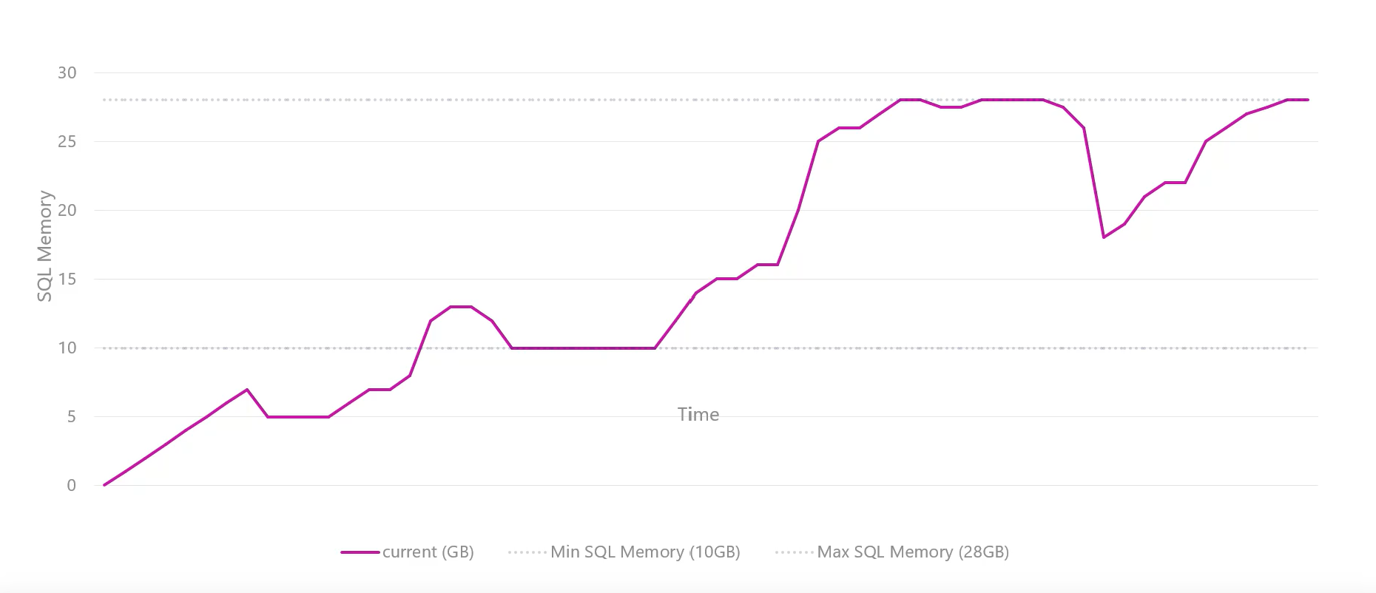
Dynamic Memory Management
Notes:
Key Points:
Low memory conditions are typically related to one of the following issues:
Buffer pool. The database caching mechanism must grow the buffer pool to improve the response time, but there is no memory remaining to do this.
VAS. Different components fail when trying to use memory because there is no VAS available.
Windows memory manager. The operating system is starting the trimming process to meet the needs of a process that is requesting memory. At this moment, SQL Server needs to discard memory to prevent it from being paged out to disk.
The Resource Monitor works in conjunction with the Windows Memory Manager and the SQL Server Memory Manager to monitor the availability of virtual and physical memory, internal cache memory targets, and the Resource Governor Pool limits. When a low memory condition is detected, notifications are passed to memory clerks who attempt to free the memory, if possible, from the various SQL Server components. Each clerk responds to the notifications in different ways depending on the component that implements the clerk. For example, the buffer pool trims memory by activating the Lazy Writer thread, while the CLR clerk may initiate Garbage Collection, and so on.

Slide 26
SQL Server Buffer Pool
Stores 8 kilobytes (KB) pages of data to avoid repeated disk I/O.
Pages held in the buffer until the space is needed by something else.
Largest percentage of SQL Server memory.
Separate buffer pool nodes for each hardware NUMA node.
Physical
Read
Logical
Read
Memory
Buffer Pool
Disks
/* physical Reads & Logical Reads can be obtained with */
SET STATISTICS IO ON
Notes:
Key Points:
The buffer pool generally represents the largest percentage of SQL Server memory. In NUMA systems, there will be a separate buffer pool node for each NUMA node.
The buffer pool abstracts the physical location of data and provides caching functions. All data accessed by SQL Server goes through the buffer pool. Therefore, the buffer pool can determine the data that should be stored in the cache to boost performance for frequently used objects.
There are two ways that the data is accessed from the buffer pool:
Logical read. Indicates that the data requested is already present in the cache. A logical read-only involves memory access, so the response time is optimum.
Physical read. Indicates that the data requested is not present in the cache, so the data must be found by using the database files. A physical read is a disk I/O operation, which is more expensive than memory access. When the I/O operation completes, the request is satisfied and the data is stored in the cache so that it can be accessed later.
When a query runs, the database pages that contain the data required to return the query result may or may not be located in physical memory. The query does not have the notion of data locality; it simply requests the page from the buffer pool.
If the pages are in memory, then there is a logical read of the page, which results in a cache hit. If the page is not in memory, then there needs to be a physical read of the page from the disk subsystem. This results in a cache miss event.
Additional Reading:
Buffer Management
https://docs.microsoft.com/en-us/previous-versions/sql/sql-server-2008-r2/aa337525(v=sql.105)
Growing and Shrinking the Buffer Pool Under NUMA
https://docs.microsoft.com/en-us/previous-versions/sql/sql-server-2008-r2/ms345403(v=sql.105)

Slide 27
Lock Pages in Memory
Special operating system API for memory allocations.
Memory allocated through this API cannot be paged out by the operating system.
Needed to support large page allocations.
Configured by granting the Lock pages in memory security privilege to the SQL Server service account.
Notes:
Key Points:
There is often extensive discussion given to the decision of whether or not to enable locked pages in SQL Server. Many things should be considered such as the amount of physical memory available on the server, whether or not the server is dedicated to SQL Server, the version of SQL Server and the operating system and even whether the underlying hardware is physical or virtual.
The typical advice is that if you are running the latest version of SQL Server on the latest version of Windows Server, locked pages in memory (LPIM) should not be necessary. Previous versions of Windows had some issues with memory management that could cause large amounts of paging unnecessarily, requiring the use of LPIM to prevent a SQL Server instance from having a large percentage of its Working Set paged out to disk.
While the latest versions of the operating system and SQL Server do not require the use of LPIM, it is required to support Large Page memory allocations, which can be desirable in some workloads. Again, there are many considerations for whether or not to enable Large Page allocations, which are discussed in the blog post referenced below. Essentially, this setting allows for more efficient memory mapping as it leads to a smaller total number of allocations, but there can be issues such as memory fragmentation that prevent this from being effective, which must be considered.
Additional Reading:
How to enable the "locked pages" feature in SQL Server 2012
hEnable the Lock Pages in Memory Option (Windows) - SQL Server | Microsoft Docs
SQL Server and Large Pages Explained
http://blogs.msdn.com/b/psssql/archive/2009/06/05/sql-server-and-large-pages-explained.aspx

Slide 28
Shrinking the Buffer Pool
One Lazy Writer thread per hardware NUMA node
The Lazy Writer sweeps over the Buffer Pool when there is memory pressure to avoid SQL Server being paged
When the Lazy Writer searches for eligible buffers
If the buffer is dirty, an asynchronous write (lazy write) is posted so that the buffer can be later freed.
If the buffer is not dirty, it is freed.
Monitor Lazy Writer with sys.dm_os_memory_cache_clock_hands
Notes:
Key Points:
When the lazy writer process is started, it checks the size of the free buffer list. If the free buffer list is below a certain point (based on the size of the cache) or there is a low memory notification from the Resource Monitor, the lazy writer process scans the buffer cache to reclaim unused pages and write dirty pages that have a reference count of zero. This makes the reclaimed buffer pages available to new data pages, or for use by the SQL Server or Windows memory managers.
When the lazy writer finds an eligible buffer, it determines if the buffer is dirty. If it is not dirty, it can simply be unhashed and freed. Otherwise, an asynchronous write (lazy write) is posted so that the buffer can be freed up later.
The lazy writer always checks 16 buffers at a time. When sufficient free buffers are available, the lazy writer goes to sleep until the next check a second later. If it must resume its search for free buffers, it starts off at the point that it last stopped. When it reaches the end of the buffer pool, it wraps back around to the beginning and starts over. This is why it is sometimes referred to as a clock, sweeping through the buffers in a cyclical fashion.
On a NUMA system, there will be separate buffer pools for each hardware NUMA node. Each node manages its own memory, so there will be a separate lazy writer thread for each node. Because of this, it may be necessary to monitor NUMA systems via the Buffer Node performance counters rather than the Buffer Manager counters.
Reference:
https://docs.microsoft.com/en-us/previous-versions/sql/sql-server-2008-r2/aa337560(v=sql.105)

Slide 29
SQL Server Buffer Pool (Continued)
Notes:
How Buffer Management Works
A buffer is an 8 KB page in memory, the same size as a data or index page. Thus, the buffer cache is divided into 8 KB pages. The buffer manager manages the functions for reading data or index pages from the database disk files into the buffer cache and writing modified pages back to disk. A page remains in the buffer cache until the buffer manager needs the buffer area to read in more data. Data is written back to disk only if it is modified. Data in the buffer cache can be modified multiple times before being written back to disk. For more information, see Reading Pages and Writing Pages.
When SQL Server starts, it computes the size of virtual address space for the buffer cache based on a number of parameters such as the amount of physical memory on the system, the configured number of maximum server threads, and various startup parameters. SQL Server reserves this computed amount of its process virtual address space (called the memory target) for the buffer cache, but it acquires (commits) only the required amount of physical memory for the current load. You can query the bpool_commit_target and bpool_committed columns in the sys.dm_os_sys_info catalog view to return the number of pages reserved as the memory target and the number of pages currently committed in the buffer cache, respectively.
The interval between SQL Server startup and when the buffer cache obtains its memory target is called ramp-up. During this time, read requests fill the buffers as needed. For example, a single-page read request fills a single buffer page. This means the ramp-up depends on the number and type of client requests. Ramp-up is expedited by transforming single-page read requests into aligned eight-page requests. This allows the ramp-up to finish much faster, especially on machines with a lot of memory.
Because the buffer manager uses most of the memory in the SQL Server process, it cooperates with the memory manager to allow other components to use its buffers. The buffer manager interacts primarily with the following components:
Resource manager to control overall memory usage and, in 32-bit platforms, to control address space usage. Database manager and the SQLOS for low-level file I/O operations. Log manager for write-ahead logging.

Slide 30
Buffer Pool Extensions
Use non-volatile drives (solid-state drives (SSD)) to extend buffer pool.
No benefit to performance if there is enough memory in the server (adding memory is preferable, if possible).
Best to use SSD storage sized 4x-10x times of RAM size.
ALTER SERVER CONFIGURATION
SET BUFFER POOL EXTENSION ON
(FILENAME = 'os_file_path_and_name', SIZE = {SIZE KB/MB/GB})
Notes:
FAQ
Should I use BPE if I have enough SSD to fit the whole workload?
No, you will not benefit from BPE in this case.
Can I use the same SSD device for both BPE and TempDB?
SSD usually have very good IOPS, so in general you should be fine. However, make sure you have enough IOPS available, otherwise it might affect both BPE and TempDB.
What is “memory pressure”?
Page Life expectancy is low, if that number is far exceeding 5 minutes (or 300 seconds), then it is unlikely that BPE will help improve performance.
Will I see any benefits on a data warehouse type workload?
Do not expect improvements on DW workloads.
Do not use DW as n acronym for data warehouse? Please expand the term

Slide 31
Demonstration
Monitoring Memory Usage
Notes:
M03L02Demo01
This will be a series of demos found in the
E:\Demos\M03L02Demo01\Examining and Monitoring SQL Server Memory Usage.sql

Slide 32
Questions?

Slide 33
Lesson 3: Troubleshooting SQL Server Memory

Slide 34
Objectives
After completing this learning, you will be able to:
Understand how to monitor SQL Server memory
Identify tools for monitoring and troubleshooting memory issues

Slide 35
Tools to monitor SQL Server memory usage
Performance Monitor
DBCC MEMORYSTATUS
Dynamic Management Views
Ring Buffers with System Health data (status and OOM)
SQL Server Errorlog (OOM with DBCC MEMORYSTATUS dump)

Slide 36
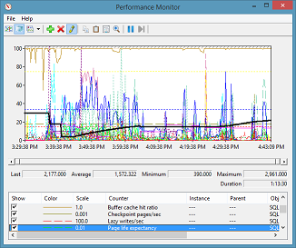
Performance Monitor Counters
Buffer Manager\Buffer cache hit ratio
Must be as close to 100% as possible
Buffer Manager\Page life expectancy
A drop of more than 30% should be investigated
Buffer Manager\Page lookups/sec
Buffer Manager\Page reads/sec
Plan Cache\Cache Hit Ratio
Must be higher than 95%
Granted Workspace Memory (KB)
Automatically calculated based on system configuration, monitor for high usage
Notes:
The Buffer Cache Hit Ratio measures the percentage of pages that were found in the buffer pool without having to incur a read from disk. This counter indicates how often SQL Server goes to the buffer and not the hard disk, to get data. The higher this ratio, the better. A high ratio, close to 100% indicates that SQL Server did not have to go to the hard disk often to fetch data and overall performance is boosted. If the Buffer Cache Hit Ratio is 100%, it would suggest that all of the pages are being accessed from the cache and does not require trips to the disk because of the optimistic read ahead mechanism but this is not exactly the case. When a user session wants to read data from the database, it will read directly from the SQL Server buffer cache (a logical read) or if the buffer cache does not have the data that is requested, the data will be read into the buffer cache from disk (a physical read) and then from the buffer cache. If the requested data is in the buffer cache, then it is called a 'buffer hit'. If the data is not in the buffer cache, it is called a 'buffer miss'. The ratio of buffer hits to total buffer requests is called the buffer cache hit ratio as can be seen from the following:
Cache Hit Ratio = (Logical Reads - Physical Reads)/Logical Reads
A read from memory takes approximately 100 nanoseconds, while a read from disk takes about 8 milliseconds or more. 1 millisecond = 1,000,000 nanoseconds The important point about SQL Server read operations is that when selecting data from the database, the user will wait on the complete read operation including all of the physical reads. The time it takes to select from the database depends on how much data will be read and how long it takes for those reads to occur. Even with cache reads, the time it takes to read a large amount of data can be significant. With physical reads, the time will be even longer. There are a few considerations to be aware of regarding the Buffer Cache Hit Ratio counter. First, unlike many of the other counters available for monitoring SQL Server, this counter averages the Buffer Cache Hit Ratio from the time the instance of SQL Server was started.

Slide 37
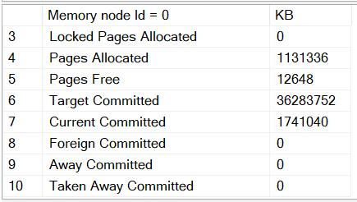
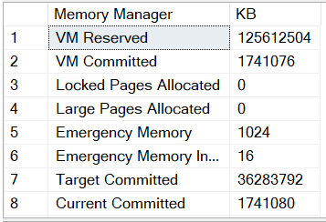
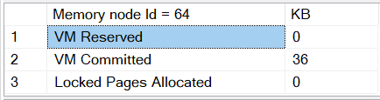
DBCC MEMORYSTATUS
Memory Manager
Summary of memory usage
Aggregate memory
Buffer distribution
Buffer pool details
Procedure cache
Global memory objects
Query memory objects
Optimization
Memory brokers
Notes:
https://support.microsoft.com/en-us/help/907877/how-to-use-the-dbcc-memorystatus-command-to-monitor-memory-usage-on-sq

Slide 38
Memory Specific DMVs
DMV Name | Purpose
sys.dm_os_process_memory | Most memory allocations that are attributed to the SQL Server
sys.dm_os_memory_brokers | Memory brokers fairly distribute memory allocations between various components within SQL Server, based on current and projected usage.
sys.dm_os_loaded_modules | Returns a row for each module loaded into the server address space
sys.dm_os_memory_objects | Returns the set of all memory clerks that are currently active in the instance of SQL Server
sys.dm_os_memory_clerks | Returns memory objects that are currently allocated by SQL Server.
Notes:
However, memory allocations might be performed in the SQL Server address space that bypasses internal memory management routines.
Memory brokers fairly distribute memory allocations between various components within SQL Server, based on current and projected usage. Memory brokers do not perform allocations. They only track allocations for computing distribution. MEMORYBROKER_FOR_CACHE : Memory that is allocated for use by cached objects (Not Buffer Pool cache). MEMORYBROKER_FOR_STEAL : Memory that is stolen from the buffer pool. This memory is not available for reuse by other components until it is freed by the current owner. MEMORYBROKER_FOR_RESERVE : Memory reserved for future use by currently executing requests.
This is one of those examples where you would have previously had to get a debugger to see a linked server to a 3rd party database, so here you can easily see what else has loaded in the SQL Server address space.
https://docs.microsoft.com/en-us/sql/relational-databases/system-dynamic-management-views/sys-dm-os-loaded-modules-transact-sql?view=sql-server-ver15
. You can use sys.dm_os_memory_objects to analyze memory use and to identify possible memory leaks.
https://docs.microsoft.com/en-us/sql/relational-databases/system-dynamic-management-views/sys-dm-os-memory-objects-transact-sql?view=sql-server-ver15

Slide 39
Ring Buffers with System Health data (status and OOM)
Microsoft has not officially documented the sys.dm_os_ring_buffers DMV, however you can query it for many different types of records.
Examples of using the sys.dm_os_ring_buffers DMV to examine:
Current memory pressure as reported by system health.
If there have been any Out of Memory (OOM) reports.
SELECT CAST(record AS XML)
FROM sys.dm_os_ring_buffers
WHERE ring_buffer_type = 'RING_BUFFER_RESOURCE_MONITOR’;
SELECT record
FROM sys.dm_os_ring_buffers
WHERE ring_buffer_type = 'RING_BUFFER_OOM';
Notes:
https://docs.microsoft.com/en-us/sql/relational-databases/extended-events/use-the-system-health-session?view=sql-server-ver15
https://docs.microsoft.com/en-us/archive/blogs/slavao/

Slide 40
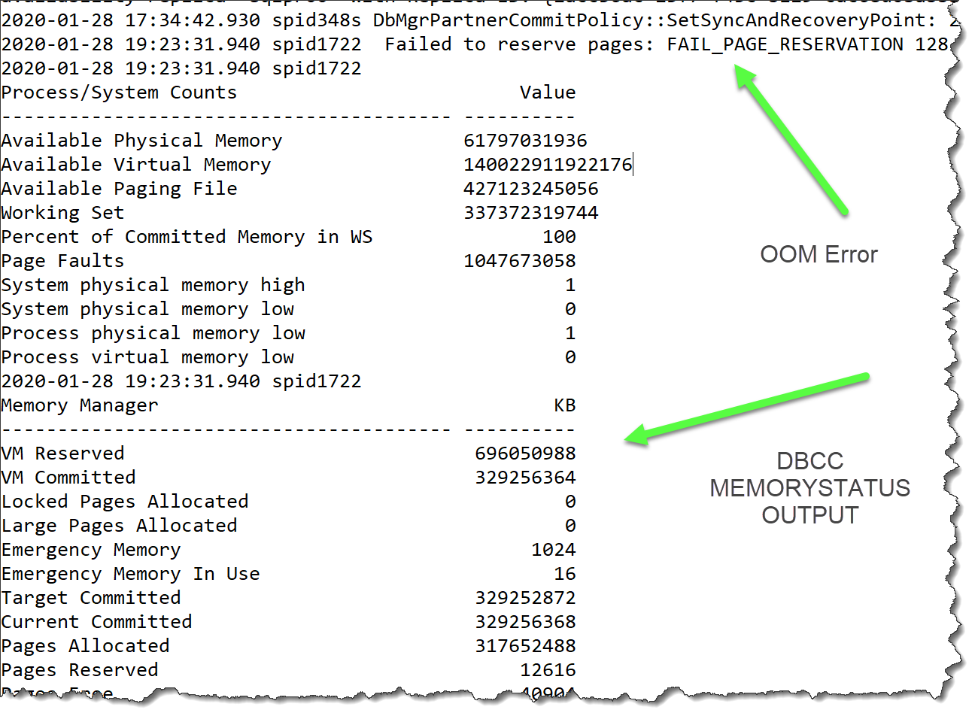
SQL Error Log
Notes:
When an Out of Memory Error is detected, it is persisted in the SQL Server Error Log and a DBCC MEMORYSTATUS output is placed into the log for troubleshooting purposes.

Slide 41

Monitoring SQL Server Memory
Notes:
M03L03Lab01

Slide 42
Questions?

Slide 43
Knowledge Check
List three features that can be used to monitor memory usage?
Which DMV allows you to view memory pressure?
Which memory component is responsible for allocating memory?
Notes:
Q1: List three features that can be used to monitor memory usage?
A1: Performance Monitor, DBCC MEMORYSTATUS, Dynamic Management Views
Q2: Which DMV allows you to view memory pressure?
A2: sys.dm_os_ring_buffers or sys.dm_os_process_memory
Q3: Which memory component is responsible for allocating memory?
A3: Memory Clerks

